Slide 1
Business Foundations 3e
Hughes, Pride, & Kapoor

Slide 2

Mastering Financial Management
Chapter
8

Slide 3
Learning Objectives
Explain the need for financial management in business.
Summarize the process of planning for financial management.
Identify the services provided by banks and financial institutions for their business customers.
Describe the advantages and disadvantages of different methods of short-term debt financing.
Evaluate the advantages and disadvantages of equity financing.
Evaluate the advantages and disadvantages of long-term debt financing.

Slide 4
What Is Financial Management?
All the activities concerned with obtaining money and using it effectively
Determining the best ways to raise money
Ensuring money is used in keeping with the organization’s goal
The need for financing
When expenses are high or sales are low
Opportunities to expand

Slide 5
Types of Financing
Short-term financing
Money that will be used for one year or less
Cash flow—the movement of money into and out of an organization
Inventory—speculative production (the time lag between the actual production of goods and when the goods are sold)
Long-term financing
Money that will be used for longer than one year
Often involves large amounts of money

Slide 6
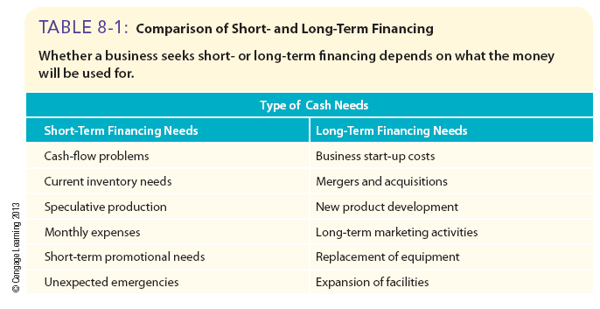
Comparison of Short- and Long-Term Financing

Slide 7
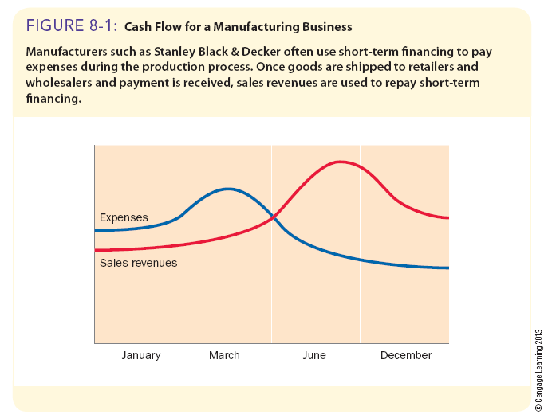
Cash Flow for a Manufacturing Business

Slide 8
Financial Management During the Economic Crisis
Financial management during the economic crisis
More difficult to use many traditional sources of short- and long-term financing
More difficult for companies to sell commercial paper
Number of corporations selling stock for the first time to the general public decreased
The number of businesses filing for bankruptcy increased

Slide 9
Financial Management During the Economic Crisis (cont.)
Proper financial management at all times must ensure that:
Financing priorities are established in line with organizational goals
Spending is planned and controlled
Sufficient financing is available when it is needed
Credit customers pay their bills on time and past-due or delinquent accounts are reduced
Bills are paid promptly to protect the firm’s credit rating and ability to borrow money
Funds are always available to pay taxes on time
Excess cash is invested in CDs, government securities, or conservative marketable securities

Slide 10
Risk-Return Ratio
The risk-return ratio
Based on the principle that a high-risk decision should generate higher financial returns for a business and more conservative decisions often generate lesser returns

Slide 11
Planning—the Basis of Sound Financial Management
Financial plan
A plan for obtaining and using the money needed to implement an organization’s goals
Developing the financial plan
Establish organizational goals
Determine how much money is needed to accomplish each goal
Identify sources of funds and which to use

Slide 12
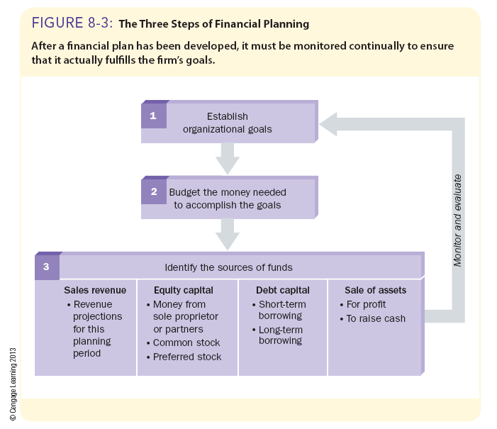
The Three Steps of Financial Planning

Slide 13
Developing the Financial Plan
Establishing organizational goals
Goal
An end result that an organization expects to achieve over a one- to ten-year period
Must be specific and measurable
Must be realistic

Slide 14
Developing the Financial Plan (cont.)
Budgeting for financial needs
Budget
A financial statement that projects income and/or expenditures over a specified future period
Usually begins with sales and various types of expenses
Cash budget
Projects cash receipts and expenditures over a specified period
Traditional
Based on dollar amounts in budget for preceding year
Zero-based budgeting
Every expense in every budget must be justified
Capital budget
Estimates a firm’s expenditures for major assets and its long-term financing needs

Slide 15
Developing the Financial Plan (cont.)
Identifying sources of funds
Sales revenues
Provide the greatest part of the firm’s financing
Equity capital
Money received from the owners or from the sale of shares of ownership in the business; long-term financing
Debt capital
Borrowed money obtained through loans
Proceeds from the sale of assets
If absolutely necessary or when no longer needed
Monitoring and evaluating financial performance
Prevents minor problems from becoming major ones

Slide 16
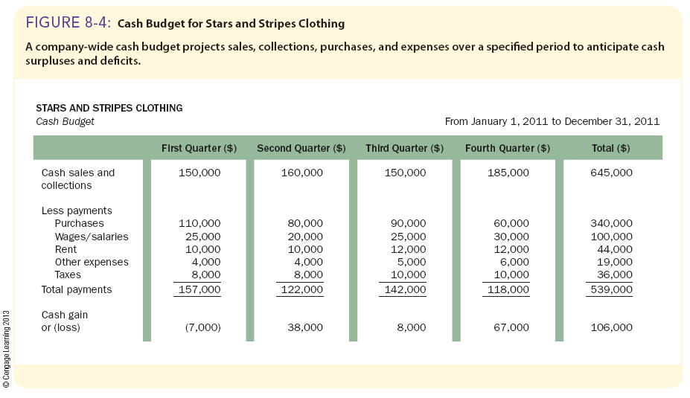
Cash Budget for Stars and Stripes Clothing

Slide 17
Class Exercise
Exercise: Divide the class into groups of three or four students. Each group represents a household with a monthly net income of R21 000. Rent costs R6500 per month, car payment is R4000 per month, and insurance is R800 per month. Students loan payments equal R2400 per month and utilities total about R2700 per month, depending on the season. Ask each group to prepare a budget to include the above expenses as well as additional expenses for groceries, clothing, entertainment, and miscellaneous items of you have allocated R 1000 for each. After each group has prepared a budget, tell each group that it has just been announced that, due to an economic downturn, monthly net incomes will be reduced by 20 percent. Ask each group to then make a plan for cutting expenses, where necessary, to accommodate the pay cut.

Slide 18
Traditional Banking Services for Business Clients
Checking accounts
Check—a written order for a bank or other financial institution to pay a stated dollar amount to the business or person indicated on the check
NOW account—an interest-bearing checking account
Savings accounts
Passbook savings account
Certificate of deposit (CD)—a document stating that the bank will pay the depositor a guaranteed interest rate for money left on deposit for a specified period of time
Short- and long-term loans
Line of credit—a loan that is approved before the money is actually needed
Revolving credit agreement—a guaranteed line of credit
Collateral—real estate or property pledged as security for a loan

Slide 19
Traditional Banking Services for Business Clients (cont.)
Credit card and debit card transactions
Banks and other financial institutions charge merchants fees (a percentage of each credit card transaction) for handling the transactions for the merchant
Debit card—a card that electronically subtracts the amount of a purchase from the cardholder’s bank account at the moment the purchase is made

Slide 20
Online Banking
Electronic funds transfer (EFT) system
A means of performing financial transactions through a computer terminal or telephone hookup
Changing how banks do business
Automated teller machines (ATMs)
Automated clearinghouses (ACHs)
Point-of-sale (POS) terminals
Electronic check conversion (ECC)

Slide 21
International Banking
Popular methods of paying for import and export transactions
Letter of credit
A legal document issued by a bank or other financial institution guaranteeing to pay a seller a stated amount for a specified period of time
Banker’s acceptance
A written order for the bank to pay a third party a stated amount of money on a specific date
Currency exchange

Slide 22
Sources of Unsecured Short-Term Financing
Unsecured financing
Financing not backed by collateral
Trade credit
Financing extended by a seller who does not require immediate payment after the delivery of the merchandise
Promissory notes
A written pledge by a borrower to pay a certain sum of money to a creditor at a specified future date
Unlike trade credit, promissory notes usually include interest
Legally binding
Negotiable instruments

Slide 23
Sources of Unsecured Short-Term Financing (cont.)
Unsecured bank loans
Interest rates vary with each borrower’s credit rating
Prime interest rate
The lowest rate charged by a bank for a short-term loan
Offered through promissory notes, a line of credit, or revolving credit agreement
Commercial paper
Short-term promissory note issued by a large corporation
Interest rates are usually below that charged by banks for short-term loans

Slide 24
Sources of Secured Short-Term Financing
Loans secured by inventory
Inventory is pledged as collateral
Control of the inventory passes to the lender until the loan is repaid
If the lender requires storage of inventory used as collateral in a public warehouse, the borrower pays storage fees
Loans secured by receivables
Amounts owed to a firm by its customers are pledged as collateral
Quality of receivables is considered

Slide 25
Sources of Secured Short-Term Financing (cont.)
Factoring accounts receivable
Factor
A firm that specializes in buying other firms’ accounts receivable
The factor buys accounts receivable for less than their face value
The factor collects the full dollar amounts when each account is due
The factor’s profit is the difference between the face value and what it paid for the accounts receivable
Profit is based on the risk (the probability that the accounts receivable will not be paid) the factor assumes

Slide 26
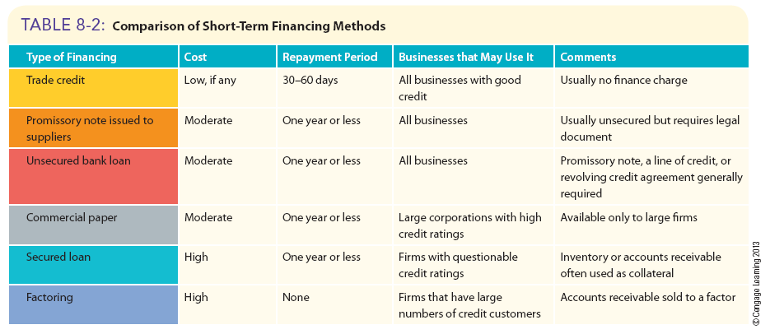
Comparison of Short-Term Financing Methods

Slide 27
Sources of Equity Financing
For sole proprietorships or partnerships
Owner or owners invest money in the business
Venture capital
For corporations
Sale of stock(shares)
Use of profits not distributed to owners
Venture capital

Slide 28
Sources of Equity Financing (cont.)
Selling shares
Initial public offering
When a corporation sells ordinary shares to the general public for the first time
Advantages of selling shares
Firm does not have to repay money received from sale of shares
Firm does not have to pay dividends to stockholders(shareholders)

Slide 29
Sources of Equity Financing (cont.)
Selling Shares (cont.)
Primary market
A market in which an investor purchases financial securities (via an investment bank) directly from the issuer of those securities
Secondary market
A market for existing financial securities that are traded between investors
Securities exchange market
Over-the-counter (OTC) market

Slide 30
Sources of Equity Financing (cont.)
Selling Shares (cont.)
Common shares(Ordinary shares)
shares whose owners may vote on corporate matters but whose claims on profits and assets are subordinate to the claims of others
Preferred stock( Preferential shares)
Shares whose owners usually do not have voting rights, but whose claims on dividends and assets are paid before those of ordinary share owners
Par value
An assigned (and often arbitrary) dollar value printed on a stock certificate

Slide 31
Sources of Equity Financing (cont.)
Retained earnings
The portion of a corporation’s profits not distributed to stockholders
Venture capital
Money invested in small (and sometimes struggling) firms that have the potential to become very successful and extremely profitable
Investors usually receive an equity or ownership position in the business and share in its profits
Private placement
Stock and other corporate securities are sold directly to insurance companies, pension funds, or large institutional investors

Slide 32
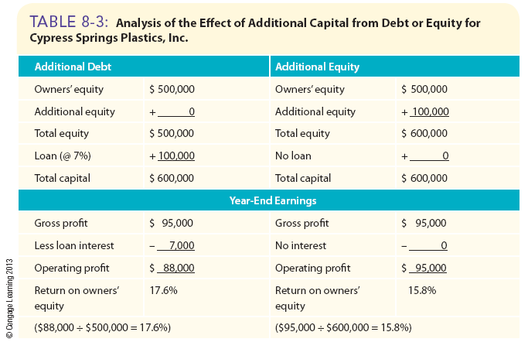
Effects of Additional Capital

Slide 33
Sources of Long-Term Debt Financing (cont.)
Long-term loans
Term-loan agreement
For loans longer than one year.
A promissory note requires a borrower to repay a loan in monthly, quarterly, semiannual, or annual installments.
Interest rate and repayment terms are based on the reasons for borrowing, the firm’s credit rating, and the value of collateral.
The basics of getting a loan
Know potential lenders.
Maintain a good credit rating.
Fill out an application, submit a business plan and financial statements, and compile references.
Meet with loan officer.
If denied, determine why.

Slide 34
Sources of Long-Term Debt Financing (cont.)
Corporate bonds
A corporation’s written pledge that it will repay a specified amount of money with interest
Maturity date—the date on which a corporation is to repay borrowed money
Interest is paid until maturity
Types of bonds
Registered bond—a bond registered in the owner’s name by the issuing company
Debenture bond—a bond backed only by the reputation of the issuing corporation
Mortgage bond—a bond secured by various assets of issuing firm
Convertible bond—a bond that can be exchanged, at the owner’s option, for a specified number of shares of the corporation’s common stock

Slide 35
Sources of Long-Term Debt Financing (cont.)
Corporate bonds (cont.)
Repayment provisions for corporate bonds
Bond indenture—a legal document that details all the conditions relating to a bond issue
Call premium—an amount paid to the bond owner if the corporation buys back the bond before the maturity date
Serial bonds—bonds of a single issue that mature on different dates
Sinking fund—a sum of money to which deposits are made each year for the purpose of redeeming a bond issue
Trustee—an individual or an independent firm that acts as the bond owner’s representative

Slide 36
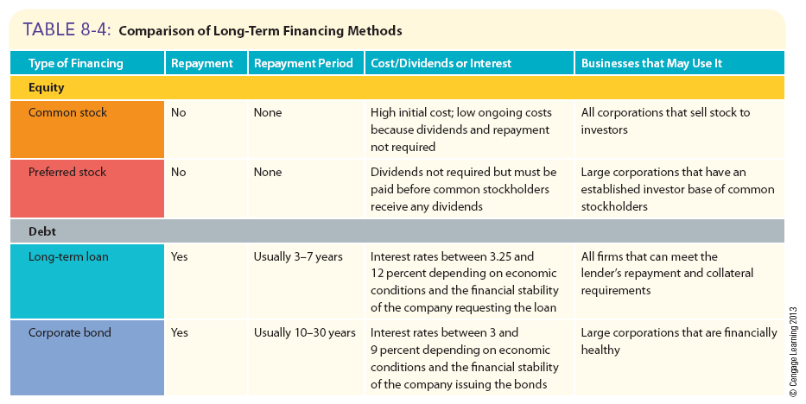
Comparison of Long-Term Financing Methods

